Slide 1
The Round Table
Prototype
Dibya Dey, DeAndre Cheong, Juan Ospina, Jake Lorah, Justin Quinones

Slide 2
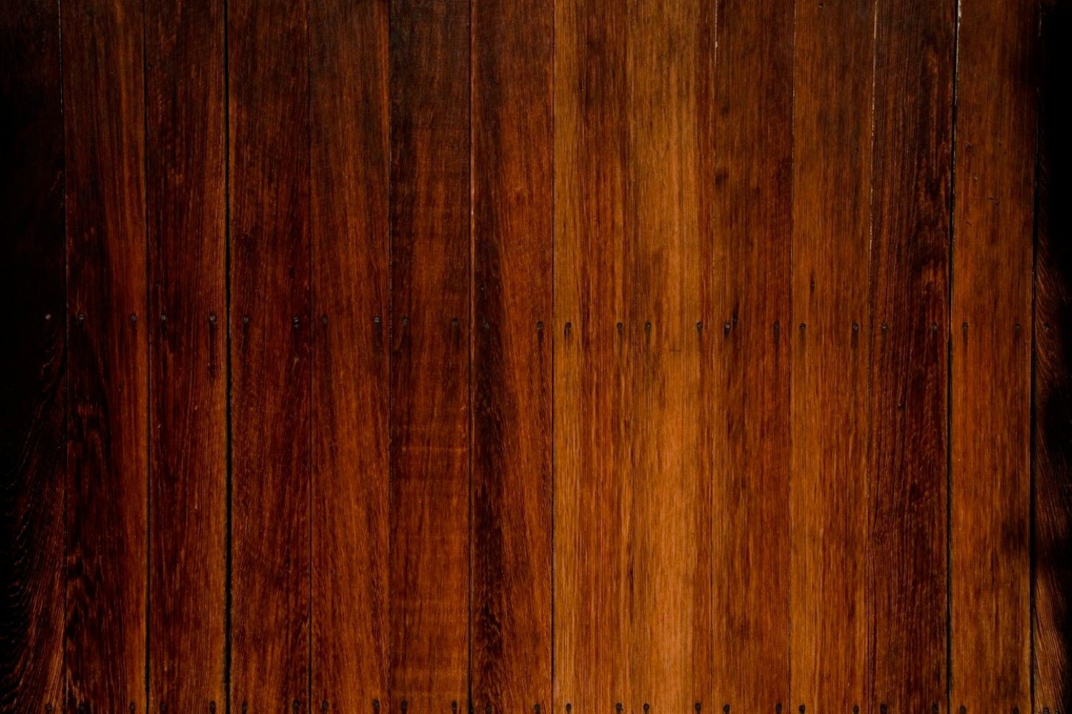

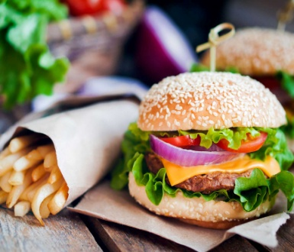
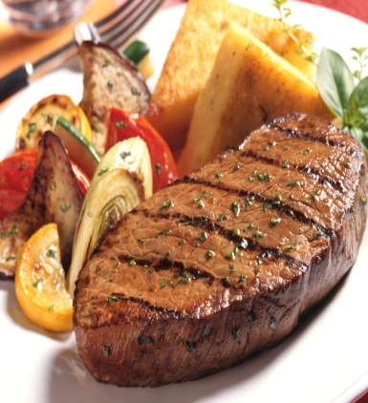
The Round Table
Home
Menu
Specials
Order Online
Make a Reservation
Comments/Questions
Directions/Contact Us
Wood
Background
Welcome to The Round Table!
American Bar & Grill
We Serve Your Basic, Delicious American Food!
Wood
Background
436 Pulis Ave, Franklin Lakes, NJ 07417
973-275-2654

Slide 3
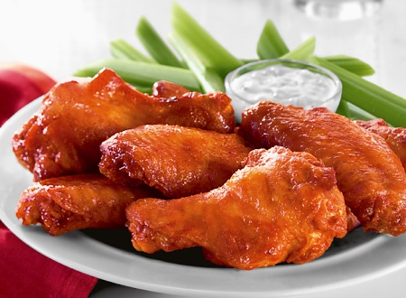
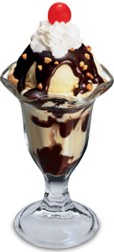
The Round Table
Menu
Appetizers:
Buffalo Wings (6 pieces)
Mozzarella Sticks (6 sticks)
Main Meal:
NY Strip Steak (8 oz)
All American Burger
Deserts:
Hot Fudge Sundae
Slice Of Carrot Cake
Drinks:
Water
Fountain Drinks (Free Refills)
Home
Menu
Specials
Order Online
Make a Reservation
Comments/Questions
Directions/Contact Us
Wood
Background
$3.99
$4.50
$ 17
$ 7.99
$3.99
$2.99
Wood
Background
$2.50
436 Pulis Ave, Franklin Lakes, NJ 07417
973-275-2654

Slide 4

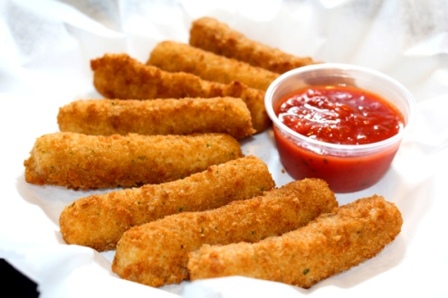

The Round Table
Buy Any 2 Appetizers, Get 1 FREE!
(Limited Time Only)
When you buy an All American Burger, you will receive a FREE small basket of fries!
(Weekdays Only)
Home
Menu
Specials
Order Online
Make a Reservation
Comments/Questions
Directions/Contact Us
Wood
Background
Wood
Background
436 Pulis Ave, Franklin Lakes, NJ 07417
973-275-2654

Slide 5
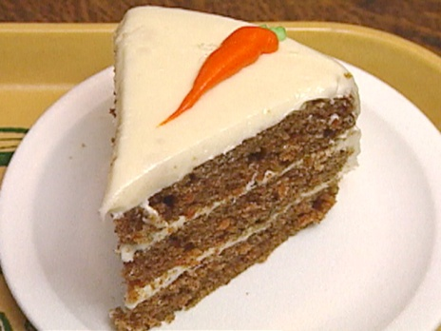
The Round Table
Order Online
Appetizers:
Buffalo Wings (6 pieces)
Mozzarella Sticks (6 sticks)
Main Meal:
NY Strip Steak (8 oz)
All American Burger
Deserts:
Hot Fudge Sundae
Slice Of Carrot Cake
Drinks:
Water
Bottle Of Coke
Home
Menu
Specials
Order Online
Make a Reservation
Comments/Questions
Directions/Contact Us
Click the button to add that item to your order
Wood
Background
$3.99
$4.50
$ 17
$ 7.99
$3.99
$2.99
Wood
Background
$1.50
Total:
Submit Order
436 Pulis Ave, Franklin Lakes, NJ 07417
973-275-2654

Slide 6
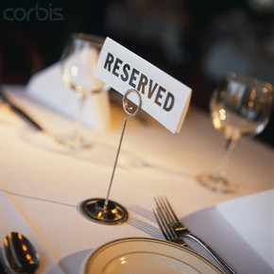
The Round Table
Make a Reservation
First & Last Name:
# of guests:
Date:
Time:
Home
Menu
Specials
Order Online
Make a Reservation
Comments/Questions
Directions/Contact Us
Wood
Background
Franklin White
2
Wood
Background
11/2/16
7:00 pm
Submit
436 Pulis Ave, Franklin Lakes, NJ 07417
973-275-2654

Slide 7
The Round Table
Comments/Feedback/Questions
Home
Menu
Specials
Order Online
Make a Reservation
Comments/Questions
Directions/Contact Us
Wood
Background
We love hearing from you!!!
Please let us know your opinion, or if you have any question you may have
*User Input*
My experience at the Round Table was very pleasing. Great service, great food, and overall just a great restaurant. I’ll be back soon!
Wood
Background
Send
436 Pulis Ave, Franklin Lakes, NJ 07417
973-275-2654

Slide 8
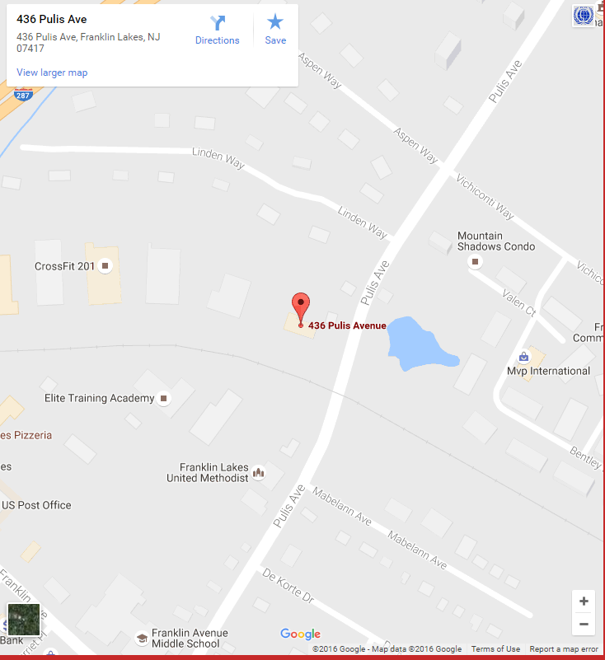
The Round Table
Directions/Contact Us
Home
Menu
Specials
Order Online
Make a Reservation
Comments/Questions
Directions/Contact Us
Wood
Background
436 Pulis Ave, Franklin Lakes, NJ 07417
Feel free to contact us anytime!!! Address: 36 Pulis Ave, Franklin Lakes, NJ 07417 Phone Number: 973-275-2654 Email: theroundtable@gmail.com
Wood
Background
436 Pulis Ave, Franklin Lakes, NJ 07417
973-275-2654

